Slide 1


Uber Case Study Internal Audit Analytics Exercise: 2020 strategy for Riyadh Market
Overview of data:
The dataset provided gives information of 40k trips in the EMEA region – Riyadh city
Number of trips:
- Completed: 28.5k (71.37%)
- Trips cancelled (rider): 10.1k (25.43%)
- Trips cancelled (driver): 1k (2.5%)
- Trips unfulfilled: 234 (0.58%)
- Fare Split: 8 (0.02%)
Average fare/ride: $6 (88% paid in cash), total fare: $177k (completed rides)
Surged trips: 25% of the completed trips

Slide 2
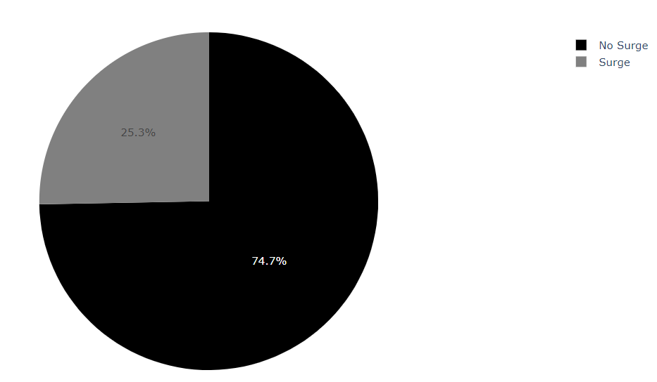
Cancellation Analysis
Driver cancellation during surge:
- Demand for rides increases -> Prices go up -> Riders pay more/ wait
a. Findings: Based on the graph, 25% of the trips are getting canceled by the driver during surge
b. Hypothesis: Due to high surge pricing, the revenue lost for uber for cancellation of a ride during surge hours will be more than the revenue lost for cancellation of a ride during non-surge hours. If the cancellations can be further reduced to less than 25% then more revenue can be generated.
c. Recommendation: Advantages of surge pricing could be explained to drivers and need to ensure that the drivers don’t cancel the rides during peak hours. Drivers could be incentivized if the trip is not getting canceled by a driver during surge hours.

Slide 3
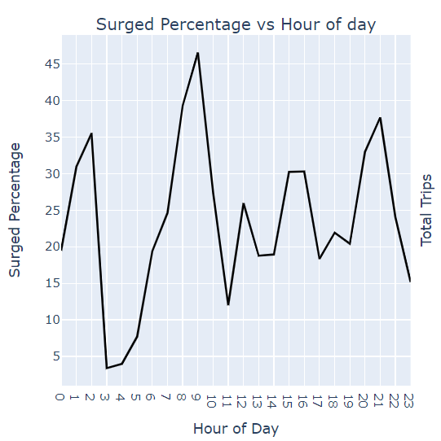
Surge Analysis
How does surge works?
- Demand for rides increases -> Prices go up -> Riders pay more/ wait
a. Hypothesis: Based on the graph, let’s assume that the average surge should be at 20%
b. Findings: There is a huge spike in rides at 9 AM (28%) and another at 9 PM (17%) – local time considered
c. Conclusion: Uber should ensure that during these times, request should be fulfilled to provide a better rider experience
d. Recommendation: Advantages of surge pricing could be explained to drivers and need to ensure that the drivers don’t cancel the rides during peak hours. Areas that are busiest during peak hours could be allocated with more drivers to ensure that requests are fulfilled

Slide 4
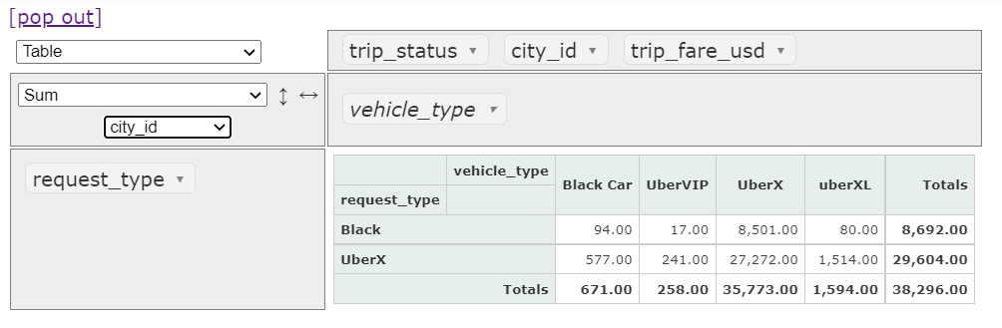
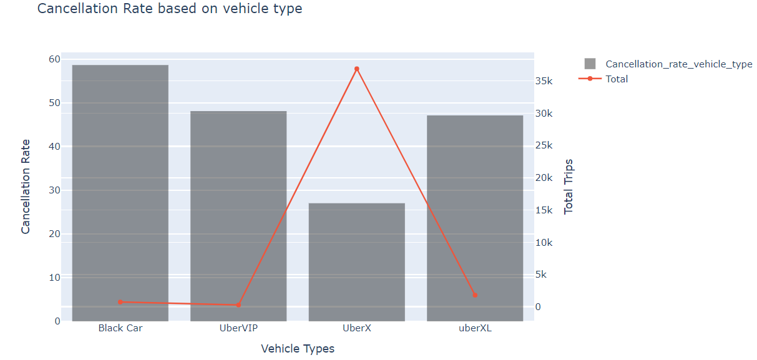
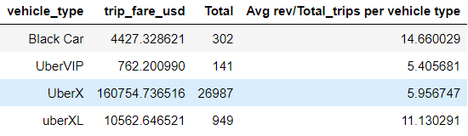
Demand-Supply Disparity Analysis
Disparity based on the vehicle type:
a. Findings: Based on table, the gap in number of Black Car requested vs the number of Black Car being the vehicle type is more than 50%. Requested #: 8692 and Vehicle Type #: 94. The demand is not met here and instead UberX is sent for the request of Black Car. From Second table, it is seen that Average fare/ trip of a Black Car is 3 times more than the average fare/ trip of UberX
b. Analysis: The revenue can be increased by supplying Black Car when requested at least by 50% (4.5k), leading to additional revenue of $38k (22% additional revenue)
c. Recommendation: Uber could focus on increasing the number of Black Cars to make sure that whenever there is a demand for Black Car, it is met.

Slide 5

Secondary Analysis
Mode of payment:
Riders in Riyadh are paying in either cash or via apps, credit/ debit cards, coupons.
a. Findings: Based on data, 84% of the rides are paid by riders in cash
b. Recommendation: Uber can build better relations with Riyadh, as Saudi Arabia is steadily moving towards building a Cashless Society by 2030, by encouraging riders to pay in cash via promotions/ offers on Uber. This can be achieved by establishing relations with companies like MasterCard, Visa, PayPal, or any local financial services.

